Slide 1
CS4012
Week 2 Lecture 2
Misrepresentation
Control Systems

Slide 2
Misrepresentation
Deliberate Misrepresentation
  Being ‘economical’ with the truth
    Advertising
    ‘Colourful’ job applications
Technical Inadequacy
  Conditions of measurement
    Fuel tanks
    Limitations of instruments (accuracy, granularity)

Slide 3
Misrepresentation
Semantic Inadequacy
  Statistics
    Opinion polls
    http://www.youtube.com/watch?v=2yhN1IDLQjo
  Interpretation
    Accounting standards and assumptions

Slide 4
Misrepresentation
The use of models is increasing as society processes more information.
  The alternatives are too inconvenient

Slide 5
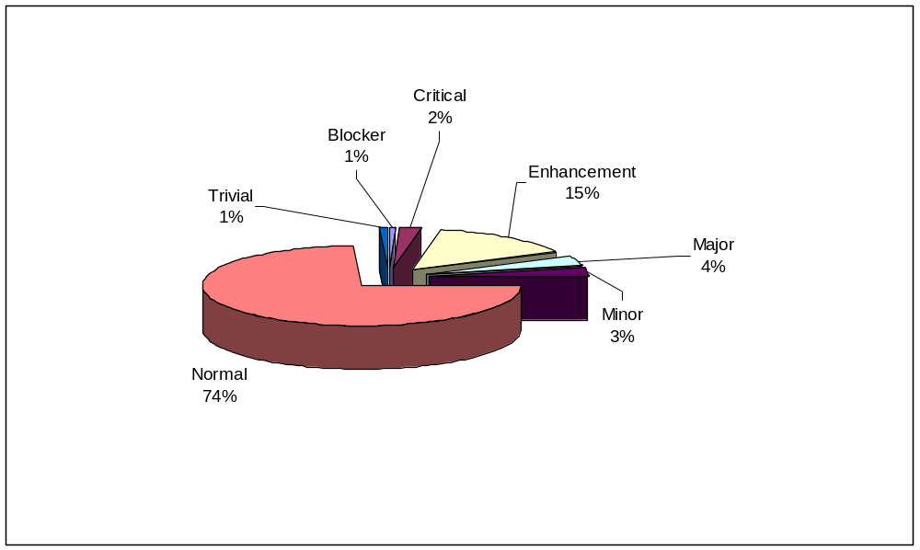
Responsibility
Modellers have responsibilities
‘Good’ models
  Authentic
  Adequate
  Accurate
E.g types of bugs
in software
Flight Simulation
Flood Planning
http://www.youtube.com/watch?v=raX5VNVHpJE
http://www.youtube.com/watch?v=oTu3P2GtSbo

Slide 6
Control Systems

Slide 7
Control Systems
Models represent ‘real things’
  Convenience
  Reasoning
Models can also control ‘real things’
  Maps used as instructions
Models are sometimes expected to control ‘real things’

Slide 8
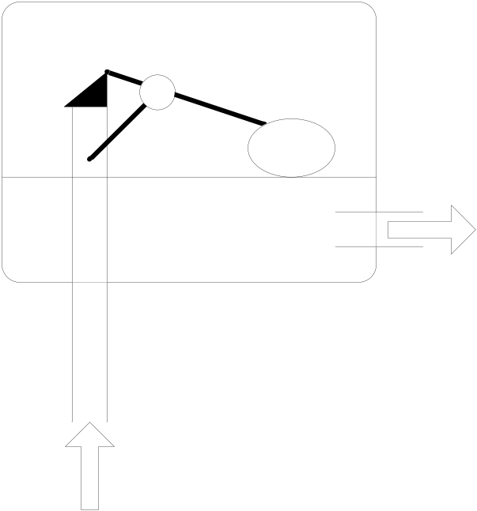
Control Systems
Ballcock assembly

Slide 9
Control Systems
Design an alternative?

Slide 10
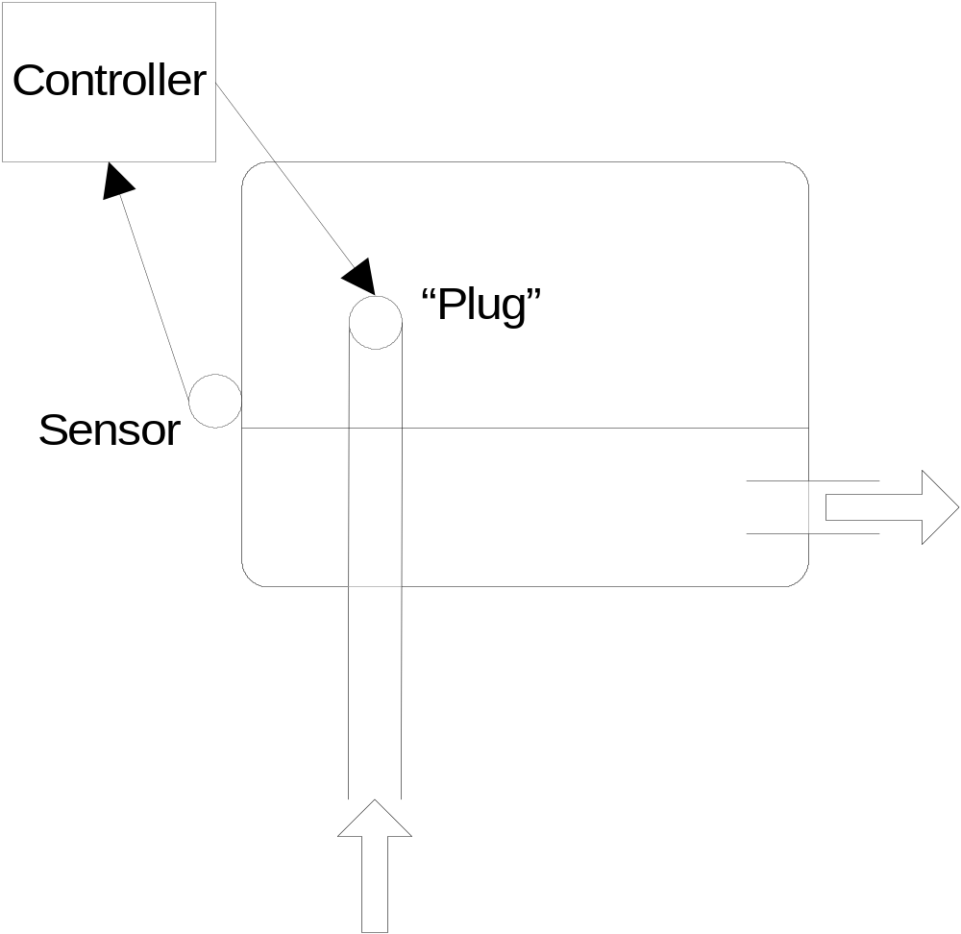
Control Systems
One alternative…

Slide 11
Control Systems
Monitor and affect the operational conditions of a dynamic system
Operational conditions: output variables
Affected by adjusting input variables

Slide 12
Control Systems
E.g. Home heating system
  Thermostat (controller)
  Air temperature (output variable)
  Heater (processor)
  Air temperature reading inside house is the feedback
  Closed-loop controller has feedback

Slide 13
Control Systems
Cruise Control in a car
  Output variable (vehicle’s speed)
  Input variable (engine’s torque)
  Implement cruise control
    Lock throttle in position?
    Hilly terrain?
    Open-loop controller

Slide 14
Control Systems
The user provides the model as a desired state – where some (or all) attributes have desired values
The system is kept in that state through some self-regulation

Slide 15
Control Systems
Driving licence points system
  The prospect of disqualification should ‘correct’ driving attitudes.
QCA
  A letter from the Academic Council should improve a student’s performance.

Slide 16
Performance in Control Systems
Latency
  Many control systems are ‘real-time’ systems with timing constraints.
    Trading systems
    Control systems in power stations
    Flight simulations

Slide 17
Control Systems
Sensors are used to examine the state of reality
Effectors are used to bring reality back into line with the model

Slide 18
Summary
Misrepresentation
Control Systems
  Desired state
  Examples
  Open and closed controllers
  Sensors and effectors

